Slide 1
EMOTIVE ETHICS
CLASS LED BY WHITE TIGER – MARCH 26
Notes:
http://www.youtube.com/watch?v=PKY-smJ6aBQ

Slide 2
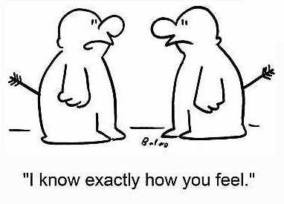
Empathy
Empathy = the power of projecting one’s personality into (and so fully comprehending) the object of contemplation (pg. 562)
Empathetic Listening (pg 81)
Would you pass the empathy test?
What is the definition of empathy?
What is Empathetic listening?

Slide 3
It’s Quiz time!
Reflection → Did you get them all right?

Slide 4
Best and Worst Times of Last week
Now is the time, to open your books or from memory describe your highs and lows of the last week. Use this time to practice empathetic listening.
Now that you have shared your personal blogs with the rest of us you have :
Accomplished following directions [1C]
Shown you can listen [1D]
Overcome the craziness (worst times) of the week [1A]
Display a positive attitude when explaining your best part of the week [1B]
You have completed the immediate practical goals of this course for today

Slide 5
How are you feeling right now?
Experimental Learning
Smiley- Face Feeling Guide
Or turn to page 553

Slide 6
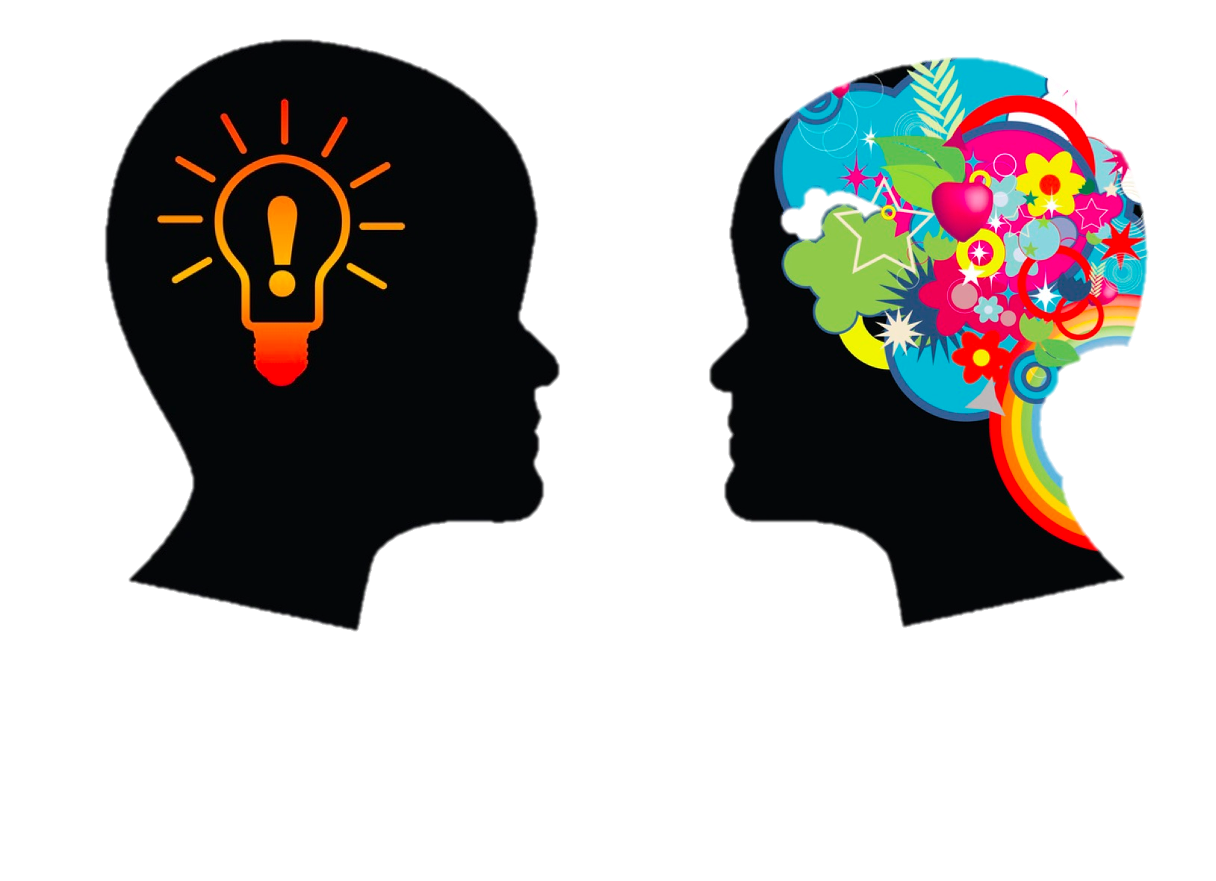
DO YOU HAVE EMOTIONAL INTELLIGENCE?
What is emotional intelligence?
The ability to be aware of and manage and other peoples emotions (Goleman)
Self awareness – emotional, accurate self-assessment, self-confidence
Self management – self-control, transparency, adaptability, achievement
Social awareness – empathy, organizational awareness, service
Page 529

Slide 7
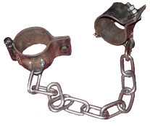
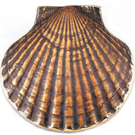
Symbols of emotive ethics

Slide 8
Manacles
Unexamined ideologies and beliefs
Keeping our emotions inside
Being able to have strong emotional literacy is being able to be free
Learn to develop your own character and conscience
Releasing fear and sorrow
YE SHALL KNOW THE TRUTH AND THE TRUTH SHALL SET YOU FREE
“Mind-forged manacles” described by William Blake in his poem “London”

Slide 9
Hammer
Making the connection between our emotions and our intellect
Understanding our feelings and no longer doubting them
Hammer your head and your heart into unity to achieve emotional intelligence
“ONLY CONNECT!...LIVE IN FRAGMENTS NO LONGER.” E.M. FOSTER
Notes:
Empathy quote on 537

Slide 10
Shell OF PILGRIMAGE
The Truth Will Set Us Free
We must know how to express our feelings
Replace fear, with love, compassion and empathy
BROUGHT BY BEN GLICK WHO WALKED THE LAST HUNDRED KILOMETERS OF THE WAY TO SANTIAGO DE COMPOSTELLA IN SPAIN TO BRING THIS SHELL BACK
“THEY REMINDED ALL OF US PILGRIMS THAT IN THE MIDST OF A WORLD BOTH BEAUTIFUL AND BROKEN THERE ARE SIGNS TO HELP LEAD US FORWARD, SOMETIMES RIGHT UNDER OUR FEET”

Slide 11
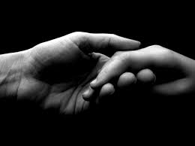
The ethics of compassion
[2a2f] To practice replacing fear and greed with love, compassion, tolerance and the sympathetic imagination
What does the word compassion mean?
Turn to page 560
What doe sympathy mean?
Conformity of feelings, inclinations, or temperament, which makes persons agreeable to each other; community of feeling; harmony of disposition. (563)
Compassion

